Slide 1



Title: Development of an AI-Powered Multi-Agent System for Monitoring Marine Pollution
Subtitle: Leveraging IBM Cloud and Watson Studio
Presented by: Solobot
Group Members:
Sagar Kumar
College: Marwari College, Ranchi , Jharkhand
IBM AI-ML Internship Project

Slide 2
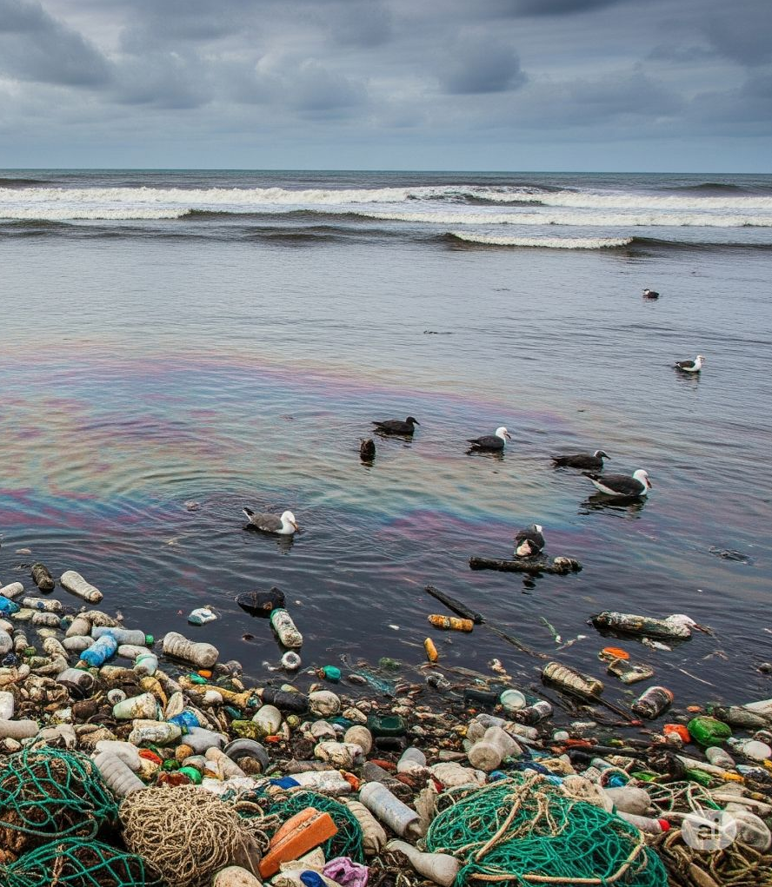
Introduction:
Marine Pollution : A global Threat
Marine Pollution is a severe and growing threats to oceans and coastal communities
It impacts ecosystems, biodiversity, and human livelihoods
This Project leverage AI to address this critical environment challenge.

Slide 3
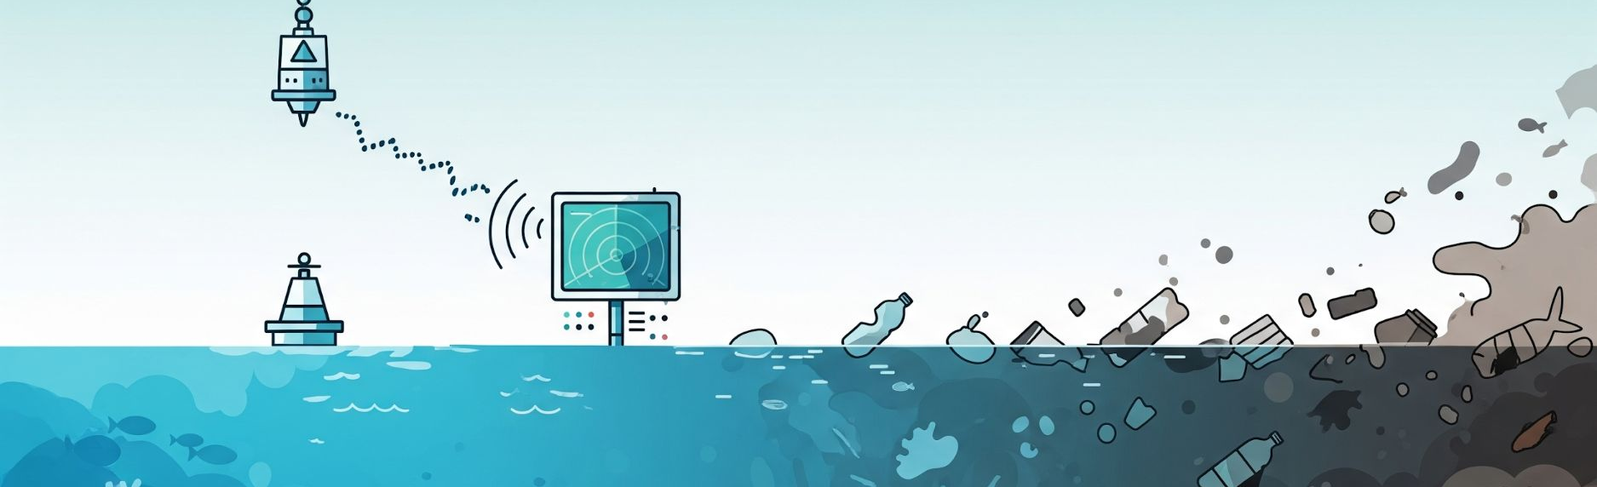
Problem Statement:
Key Challenges :
Inefficient Monitoring: Traditional methods are manual, slow, and resource-intensive, failing to provide real-time data.
Delayed Response: This leads to significant delays in detecting pollution events, hindering rapid intervention.
Escalating Damage: Consequently, pollution spreads, resulting in more extensive environmental harm and increased cleanup complexities.
Impact:
Threatens global marine ecosystems and biodiversity.
Poses risks to coastal communities and livelihoods.

Slide 4
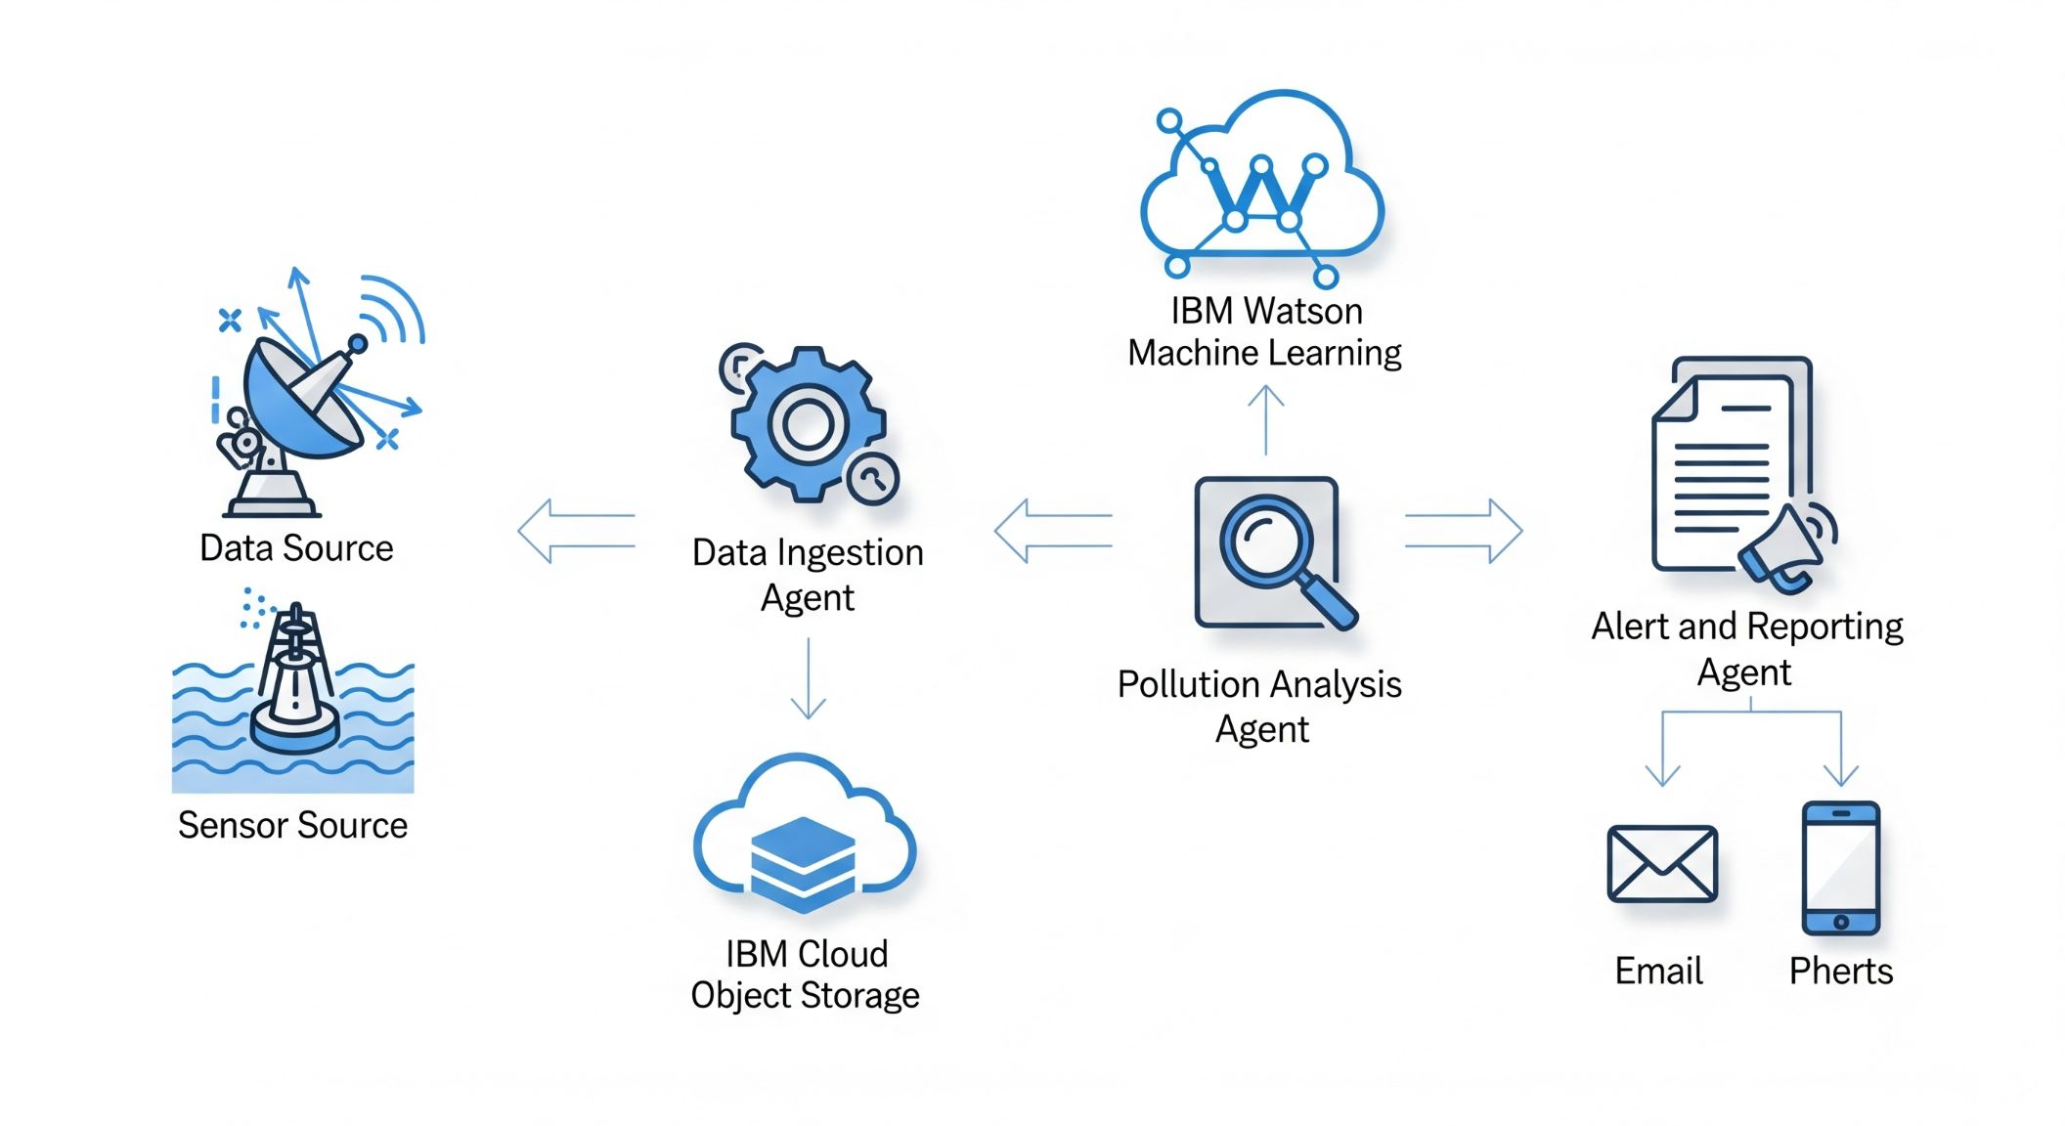
Solution
A system with three specialized agents working together to monitor marine environments.
Data Ingestion Agent: Collects data from diverse sources like satellites and sensors.
Pollution Analysis Agent: Uses a machine learning model to detect and predict pollution.
Alert & Reporting Agent: Notifies users in real-time when pollution is detected.
The system is built on IBM Cloud for scalability and reliability.
An AI-Powered Multi-Agent System

Slide 5
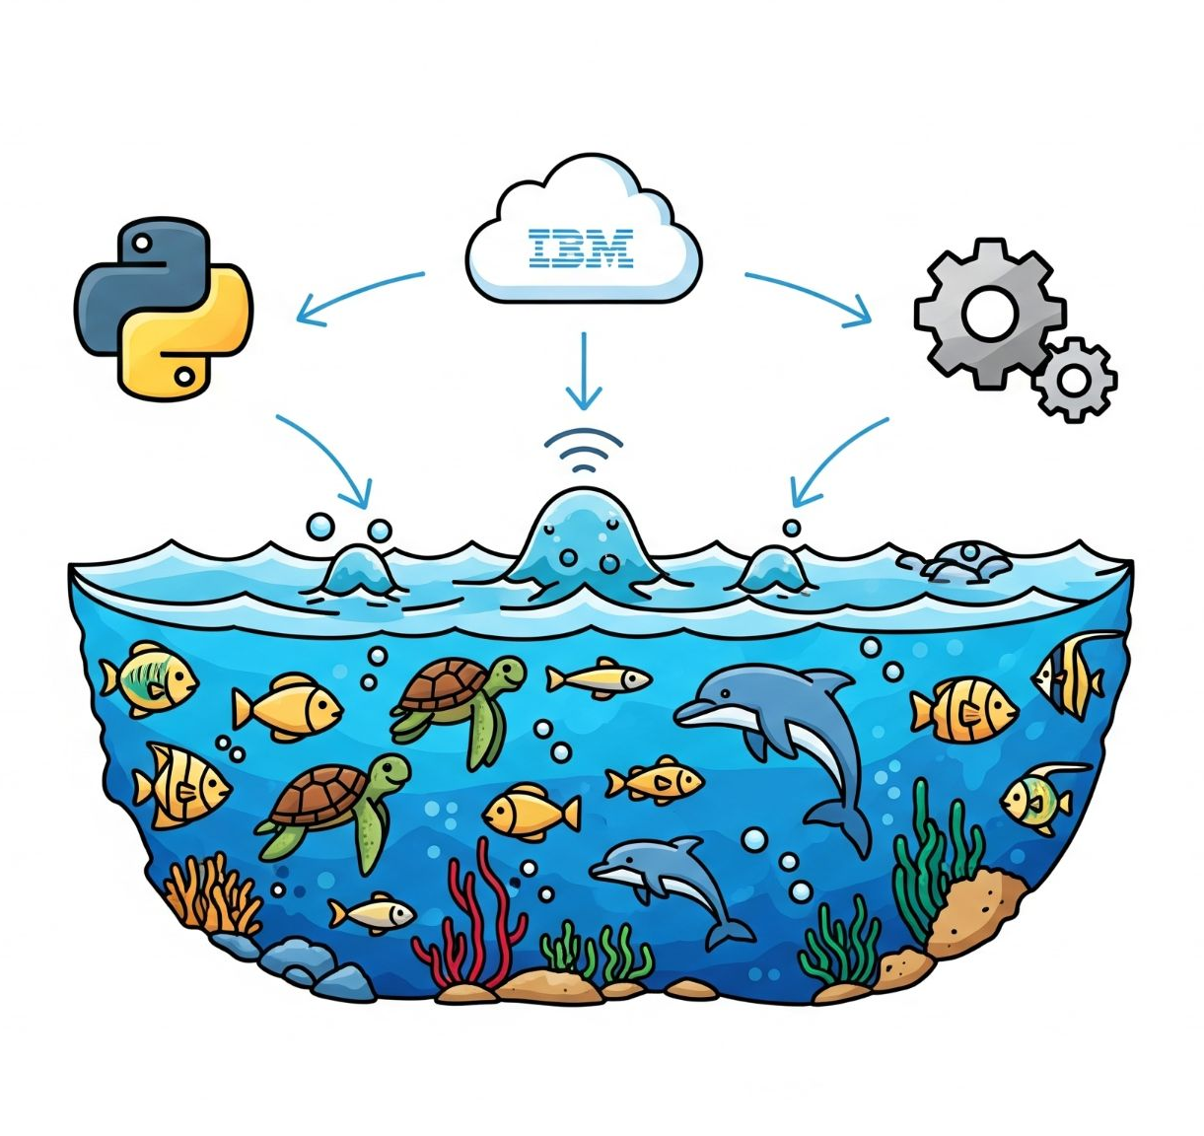
Technical Implementation & Tools
Python-based System: The entire multi-agent system is built using Python for its rich ecosystem of AI/ML libraries.
Key Libraries: pandas for data manipulation, scikit-learn for the machine learning model, and requests for API communication. IBM Cloud Services:
IBM Cloud Object Storage: For data storage and retrieval.
IBM Watson Studio: The environment used for model training and development.
IBM Watson Machine Learning: For deploying the model as a public API endpoint.

Slide 6
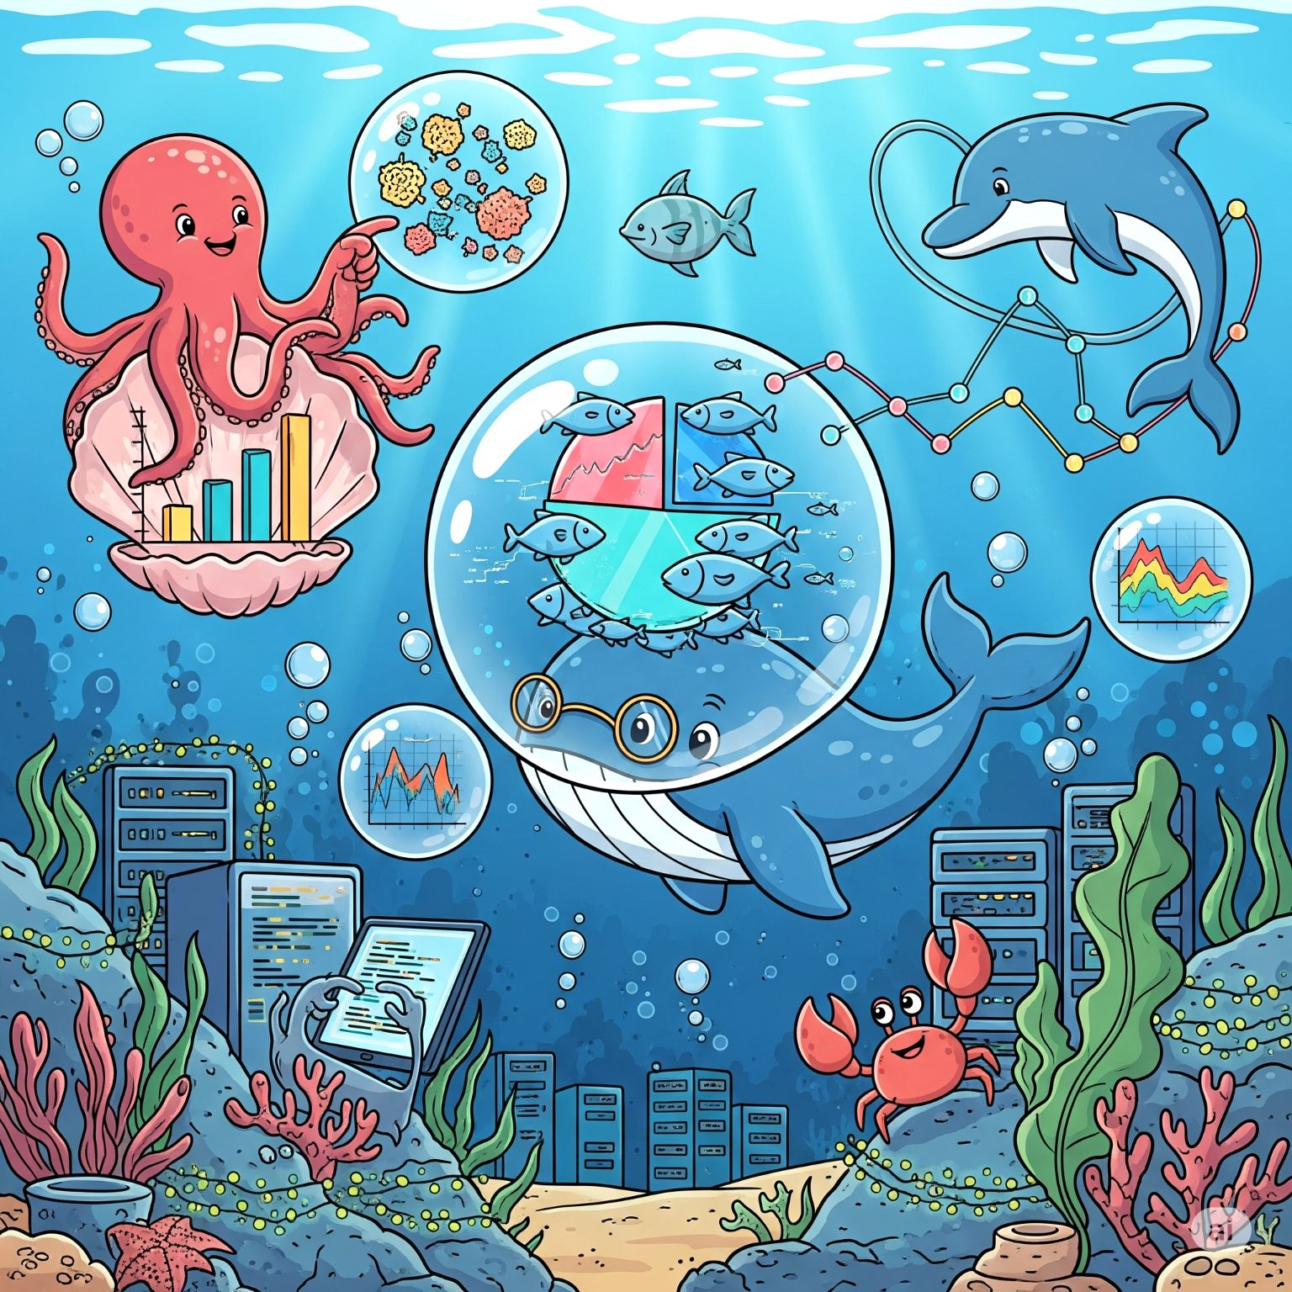
Model Training & Evaluation
Model Selection: We used a RandomForestClassifier model, which is effective for classification tasks like predicting water potability.
Training Process: The model was trained on the water_potability.csv dataset within the IBM Watson Studio environment.
Evaluation Metrics: The model was evaluated using a testing dataset to measure its performance. We focused on metrics such as Accuracy, Precision, and Recall.

Slide 7
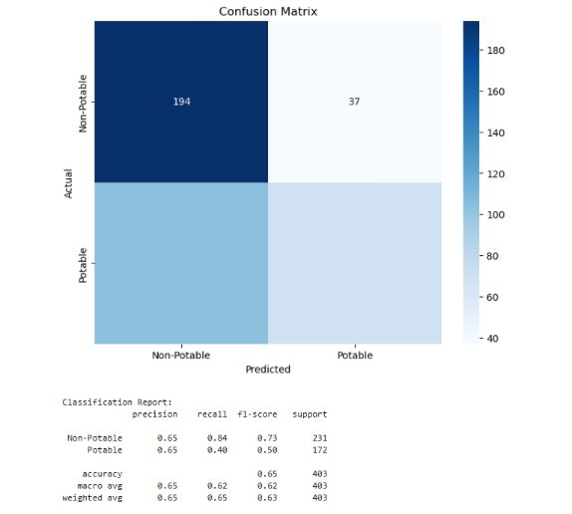
Confusion Matrix & Classification Report

Slide 8
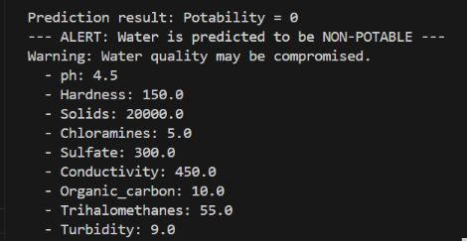
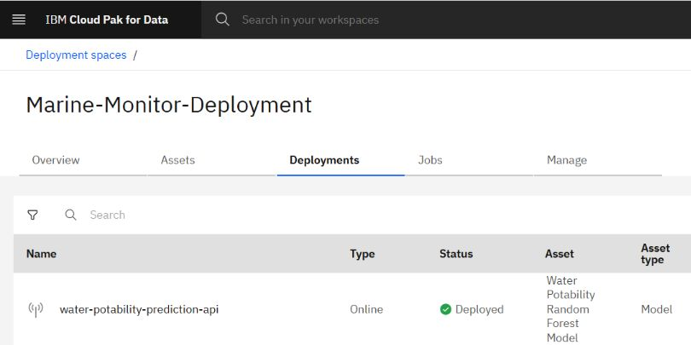
Deployed Model & Live Prediction
Model Deployment: The trained model was deployed as a REST API endpoint on IBM Watson Machine Learning.
Live Prediction: We tested the API with new data, and it successfully returned a prediction, proving the system's real-world functionality.

Slide 9
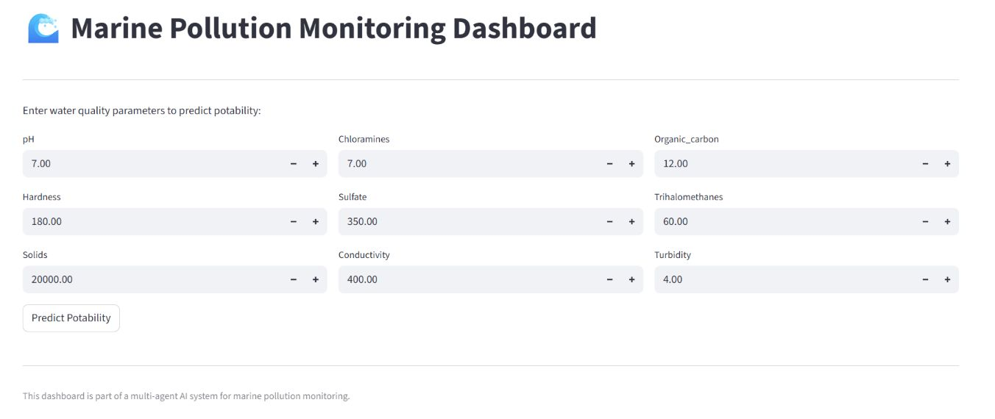
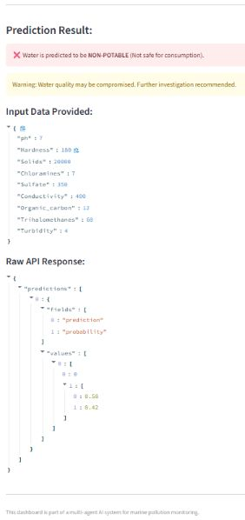
Interactive Dashboard
User-Friendly Interface: We developed a Streamlit-based dashboard to provide a simple, user-friendly interface for real-time monitoring and prediction.
Real-time Predictions: The dashboard allows users to input water quality parameters and receive an instant prediction on whether the water is potable or not.
Visualization: (If applicable) The dashboard can be extended to visualize pollution data and trends overtime, providing deeper insights.

Slide 10

Project Impact & Future Scope
Real-world Impact: The system directly supports UN SDG 14: Life Below Water by enabling timely and effective responses to pollution.
Technological Foundation: The multi-agent architecture built on IBM Cloud provides a scalable and reliable foundation for future enhancements.
Future Enhancements:
Integrate computer vision for analyzing satellite imagery to detect oil spills.
Connect to real-time IoT marine sensors for live data streams.
Deploy the dashboard publicly for wider access.

Slide 11

GitHub Repository
Project Link: https://github.com/TechWithSagar/Marine-Pollution-Monitor
Repository Content:
Core Code: The intelligent agents that power the system.
User Interface: The Streamlit dashboard files for real-time interaction.
Documentation: All project reports, presentations, and supporting files.
Setup: The necessary files to set up the project environment and dependencies.
Security: All sensitive API keys and credentials are securely stored in a .env file, which is not included in the repository.
Code Review: The repository is public, allowing for code review, contributions, and feedback.

Slide 12
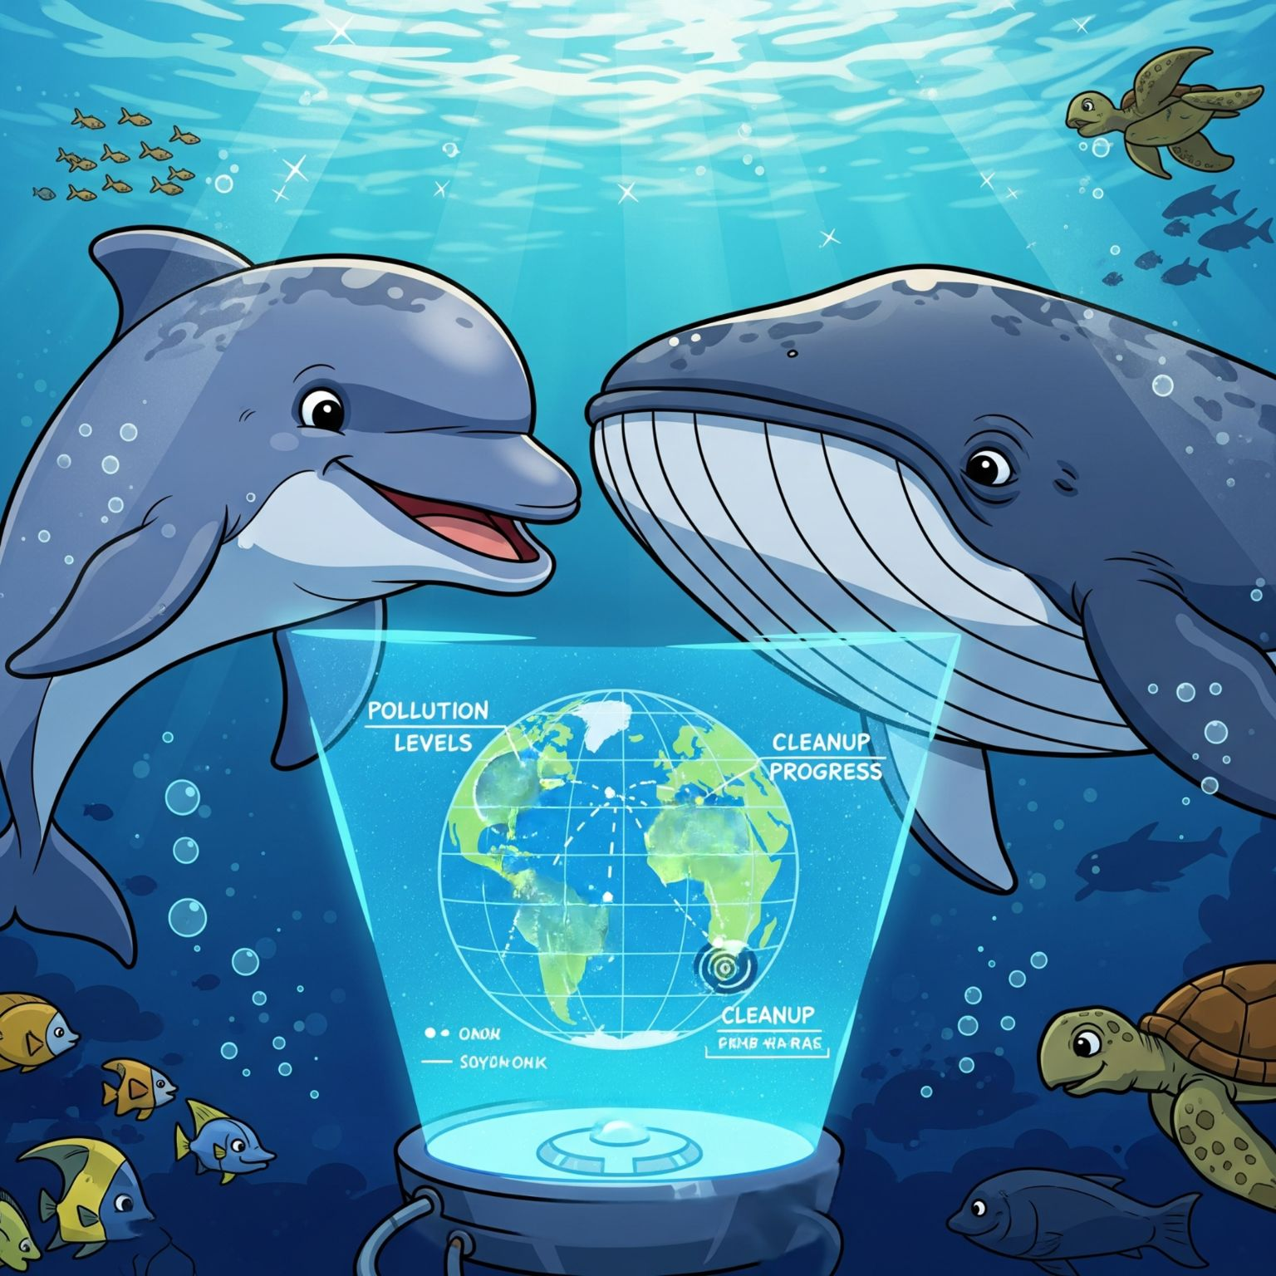
Conclusion
This project successfully developed a scalable, multi-agent AI system for marine pollution monitoring.
By leveraging IBM Cloud services, we created a robust and autonomous solution.
Our system demonstrates the potential for AI to improve environmental response, contributing directly to UN Sustainable Development Goal 14: Life Below Water.
The project provides a promising foundation for the future of real-time environmental monitoring.

